Slide 1






Work-let Name: 24ST29VIT Developing a Unified Platform for Notification Sending
Worklet Details
Worklet ID: 24ST29VIT
College Name: VIT Vellore
Team: K Senthur Kumaran, Sumit Diwedhi, Prajveen Vaishnav, Anushka Jha
Mentors: Dr Parveen Sultana H, Dr Prakash G, Mr Subrata Goswami, Mr Shubhamshekhar Kumar
  Email Notification System Twilio SMS Integration
  Telegram Bot Integration
  SDK Development Using Java Spring Boot
  Research Paper Drafted
KPIs Achieved
Date: 02-April-2025

Slide 2

Work-let Name: 24ST29VIT Developing a Unified Platform for Notification Sending
Email Notification System
✅ SMTP Server – Runs the Postfix mail server inside Docker
✅ Send from Any Domain – Supports custom sender domains.
✅ Encryption & Secure SMTP – DKIM, SPF, and DMARC, TLP Setup
Twilio SMS Integration
✅ Automated SMS Sending
✅ Secure Authentication
✅ Delivery Tracking of messages
Telegram Bot Integration
✅ Instant Notifications .
✅ Group & Individual Messaging .
✅ Secure Authentication with Telegram bot token.
🛠 SDK Development
✅ SDK for Notifications – Unified API for Email, SMS, and Telegram.
✅ Plug-and-Play Integration – using java Spring Boot.
✅ Docker Containerization
✅ Secure Credential Handling – Environment-based authentication.

Slide 3
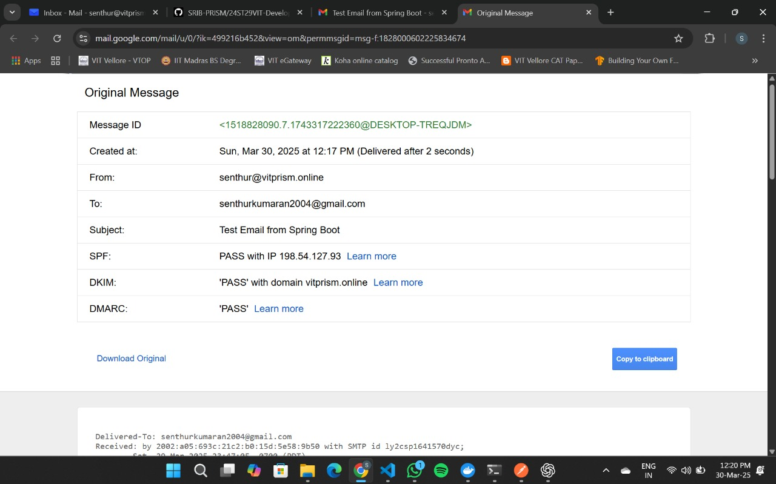
Email Service Authentication with SPF DKIM and DMARC

Slide 4
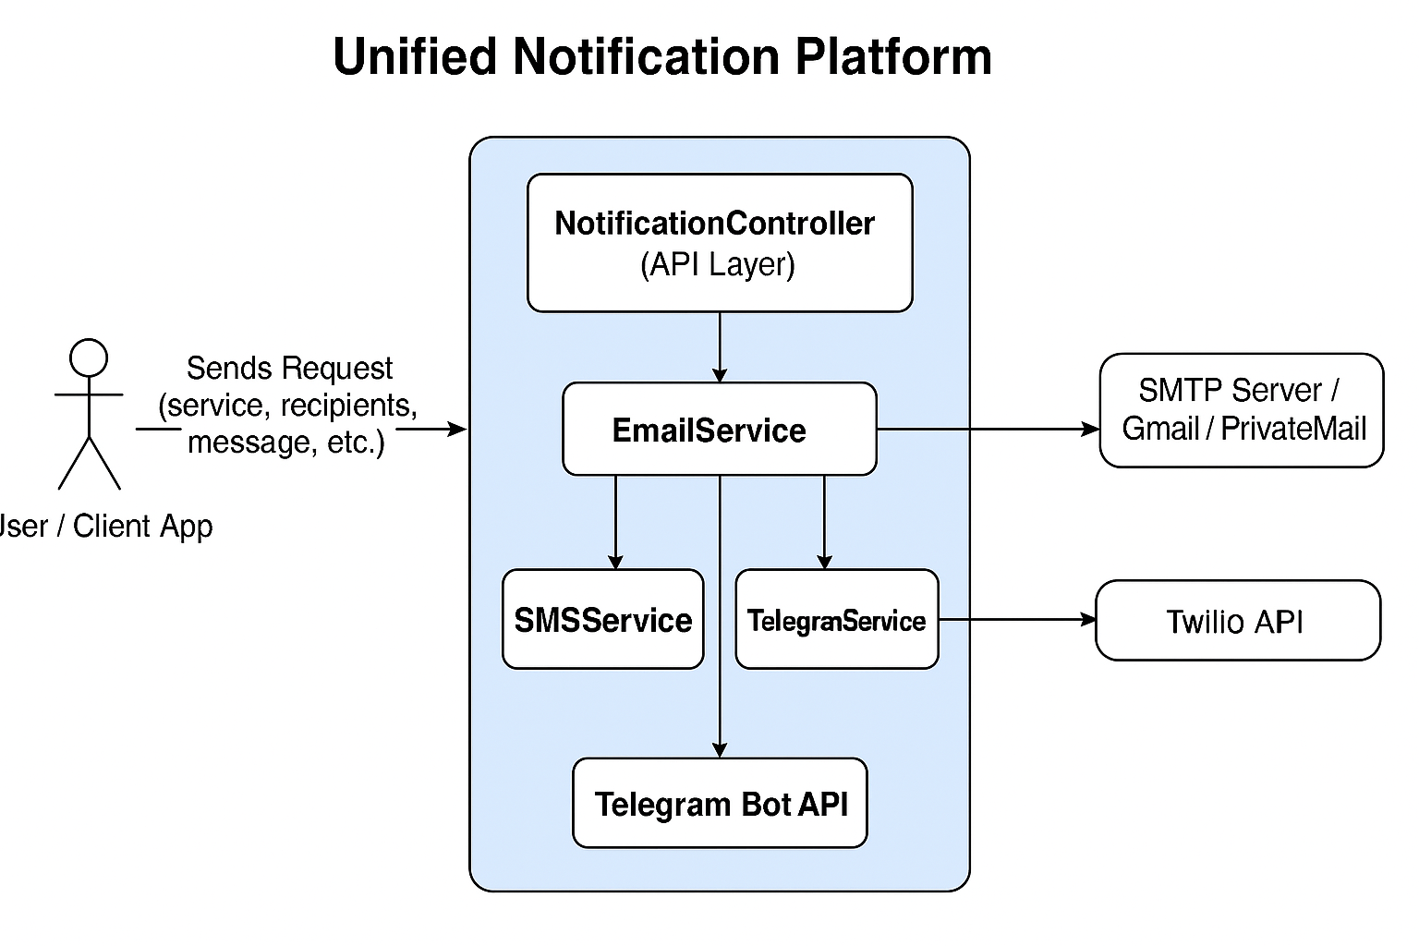
Model Architectures

Slide 5
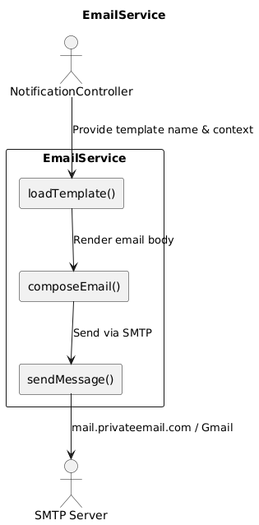
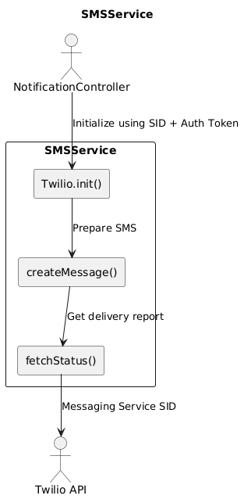
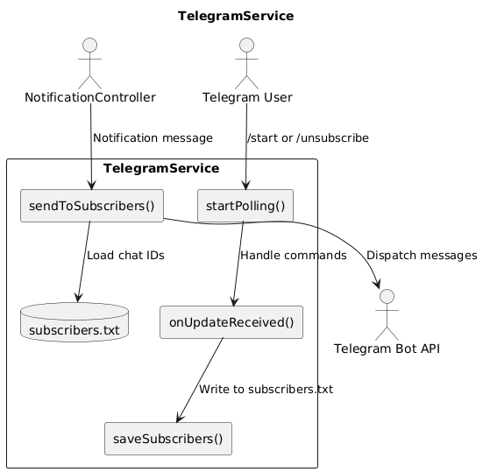
Model Architectures

Slide 6
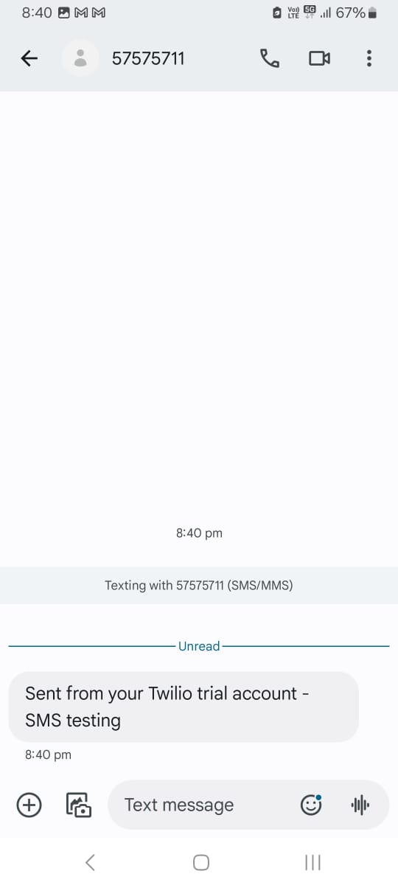
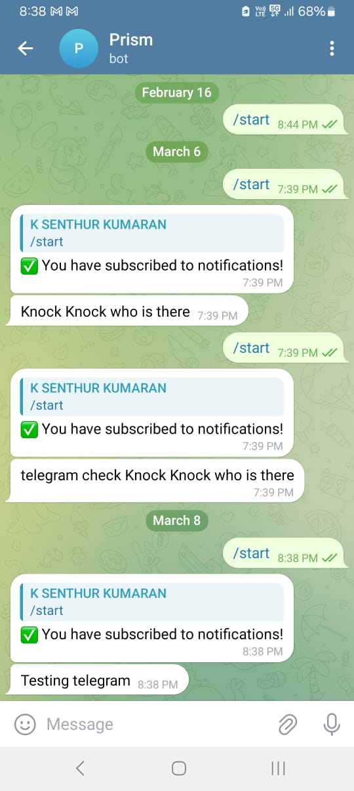
Twilio SMS
Telegram Bot

